Slide 1

RX WIP Set-up Process / How-To

Slide 2
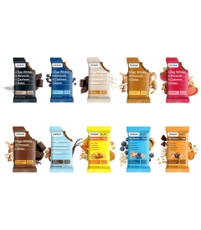
RX WIP SET-UP STEPS
RX WIP set-up requests come from LIM through Digital Concierge and NOT Evolve as a NIF is NOT required
Example SKU: 170009831
Information required to be provided by LIM:
Material Description
Material Group
**Product Hierarchy / Double check profit center / Food Form
Weight
UPC

Slide 3
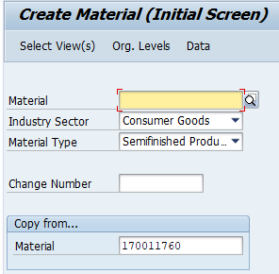
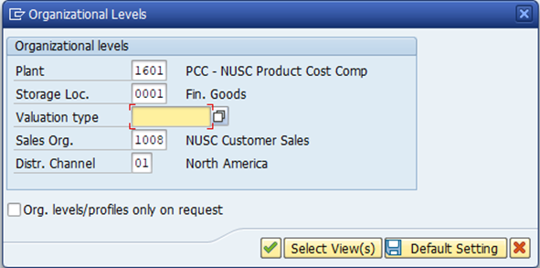
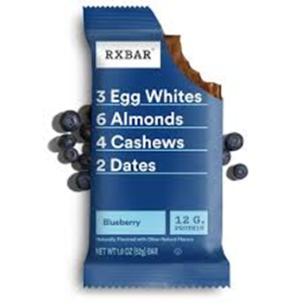
RX WIP SET-UP STEPS
SAP TCODE: MM01
Set-up steps using MM01 (Create)
Material: Do not put # in material field, SAP will populate/generate it for you
Industry Sector: Consumer Goods
Material Type: Semi-Finished
Copy From: Use an existing RX WIP Material to copy from (as shown in screenshot)
Plant: 1601
Sales Org: 1008 (RX)

Slide 4
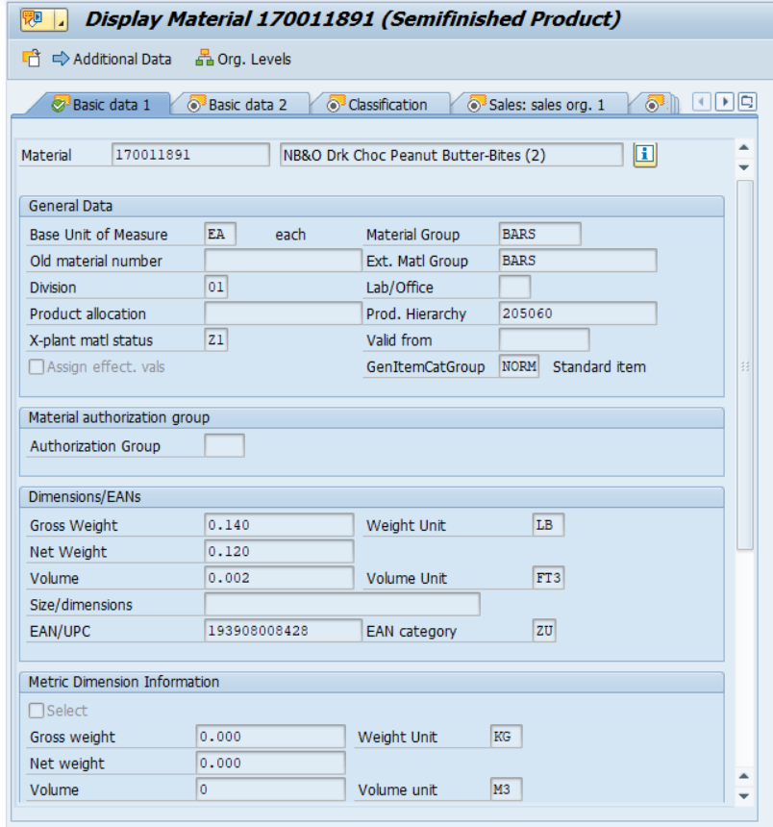
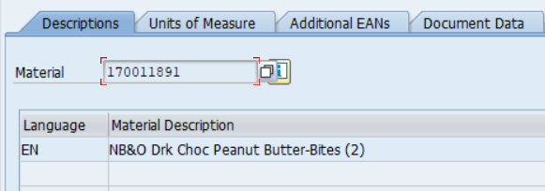
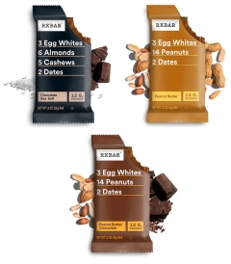
RX WIP SET-UP STEPS
SAP TCODE: MM01
MM01
SAP generated the new RX WIP SKU in Material field
Enter data in the following fields:
Material Description
Material Group
Product Hierarchy
Dimensions/EANs

Slide 5
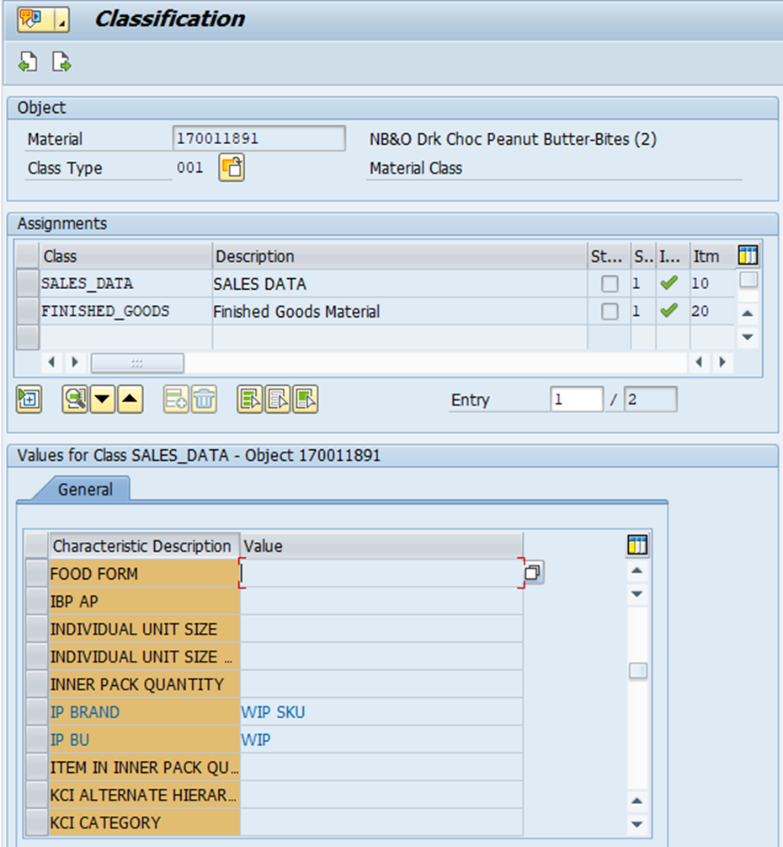

RX WIP SET-UP STEPS
SAP TCODE: MM01
MM01 Classification Tab
Enter data in the following fields:
IP Brand: WIP SKU
IP BU: WIP

Slide 6
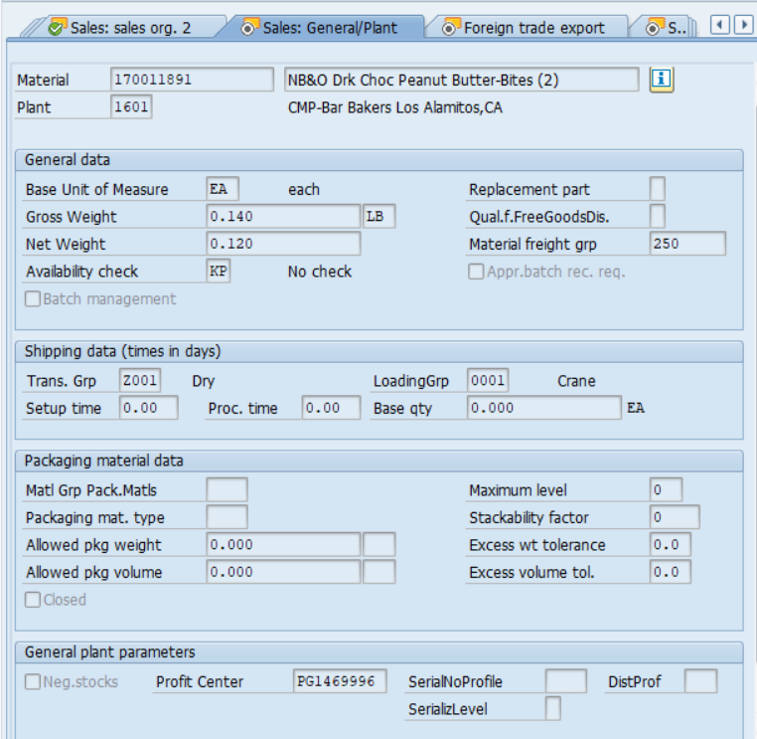
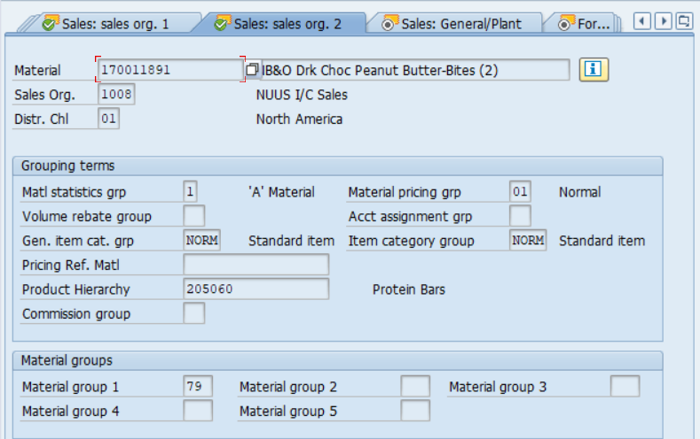

RX WIP SET-UP STEPS
SAP TCODE: MM01
MM01
Enter through the screens in the Material Master and ensure the following fields are populated
Sales Org 2 Screen ▪ Sales General/Plant
Material Group 1 ▪ Profit Center
79 WIP

Slide 7
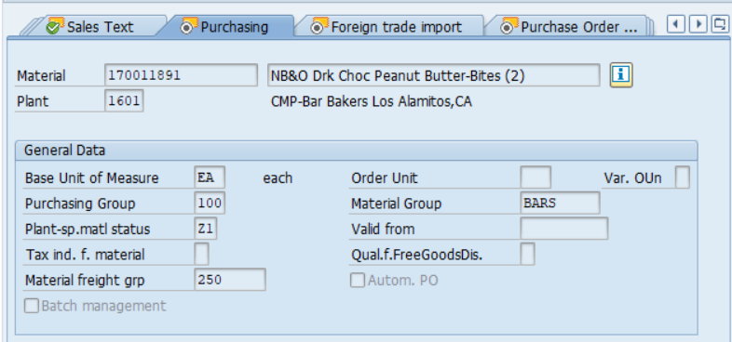
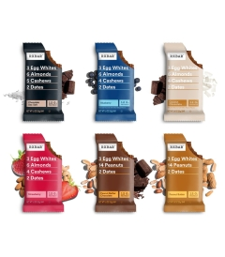
RX WIP SET-UP STEPS
SAP TCODE: MM01
MM01
Enter through the screens in the Material Master and ensure the following fields are populated
Purchasing Screen
Plant Sp.Matl Status: Z1
**Follow-up/determine on how the item gets flipped to Z2

Slide 8
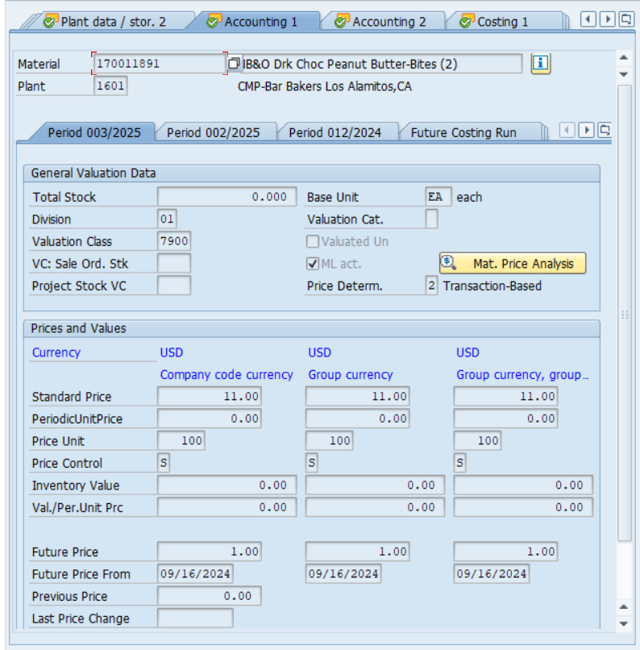

RX WIP SET-UP STEPS
SAP TCODE: MM01
MM01
Enter through the screens in the Material Master and ensure the following fields are populated
Accounting 1 Screen
Standard Price (if available)
Future Price 1.00

